Slide 1
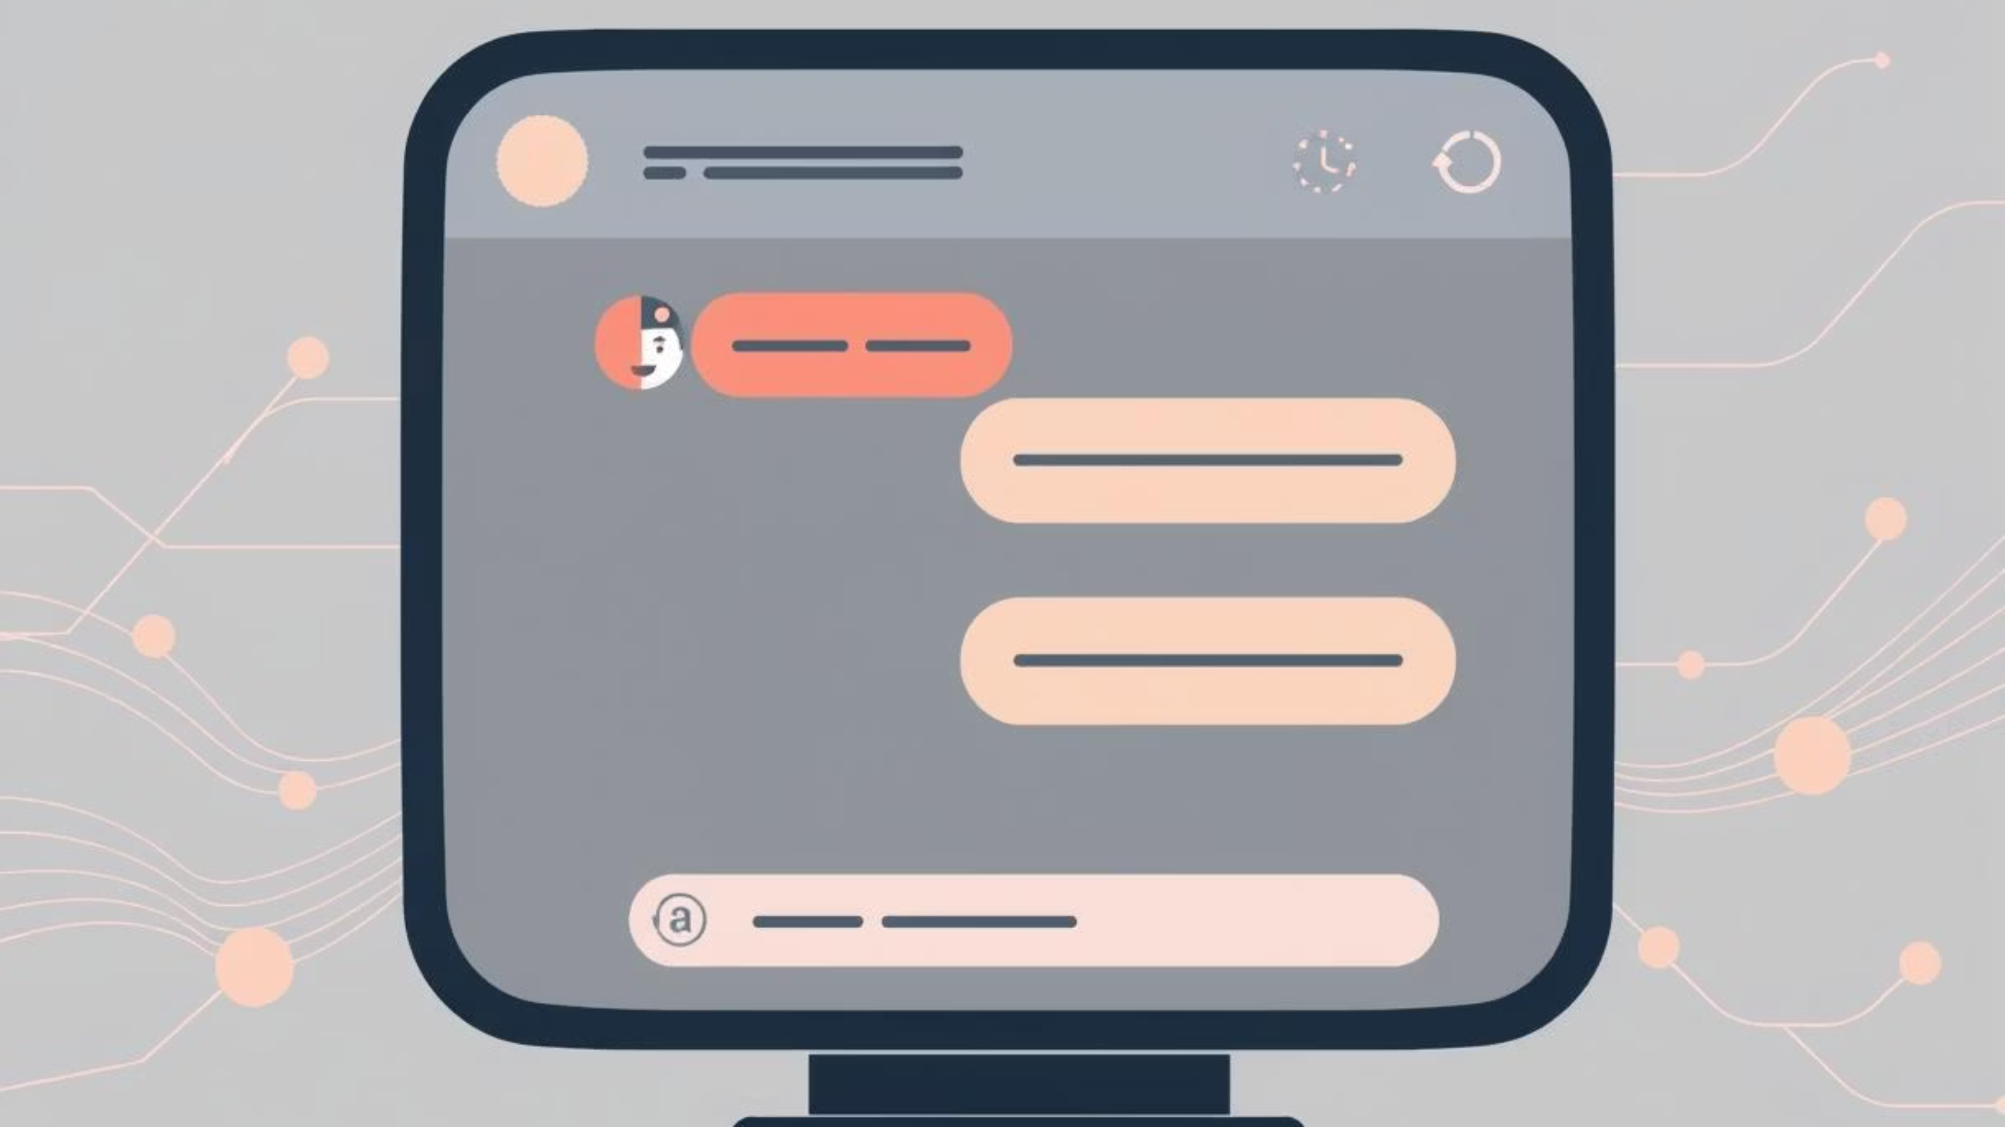
AI Chatbot with Gemini Integration: Revolutionizing Conversational AI
This document provides a comprehensive overview of the AI Chatbot with Gemini Integration project, a real-time conversational web application designed for dynamic and context-aware interactions. We will explore its core features, technical architecture, and potential for transforming how users engage with AI assistants and document content.

Slide 2
Project Vision: Intelligent & Context-Aware Conversations
"The future of interaction is intelligent, intuitive, and informed by context. Our AI Chatbot with Gemini Integration embodies this vision, creating a smart assistant that truly understands both natural conversation and document content."
The AI Chatbot with Gemini Integration aims to deliver a superior conversational experience by combining real-time interaction with advanced context-awareness. Unlike traditional chatbots, this application allows users to upload documents (PDF, Word, PPTX), enabling the AI to provide highly relevant and intelligent responses based on specific, user-provided information. This capability makes it an ideal smart assistant for various professional and personal applications.

Slide 3

Core Features: Empowering User Interaction
The AI Chatbot is packed with features designed to enhance user experience and interaction. These capabilities ensure a seamless, intelligent, and personalized conversational flow.
Real-Time Chat & Gemini AI
Document Upload & Context
Interactive UI & Themes
Experience instant, fluid conversations powered by the advanced capabilities of Gemini AI, ensuring accurate and context-rich responses.
Upload PDF, Word, or PPTX files to provide the AI with specific context, enabling highly relevant answers based on your documents.
Engage with a responsive chat interface, featuring scrollable history, live typing effects, and customizable dark/light modes for optimal viewing.
This combination of real-time processing and document understanding sets a new standard for AI assistants, making complex information accessible through natural language.

Slide 4
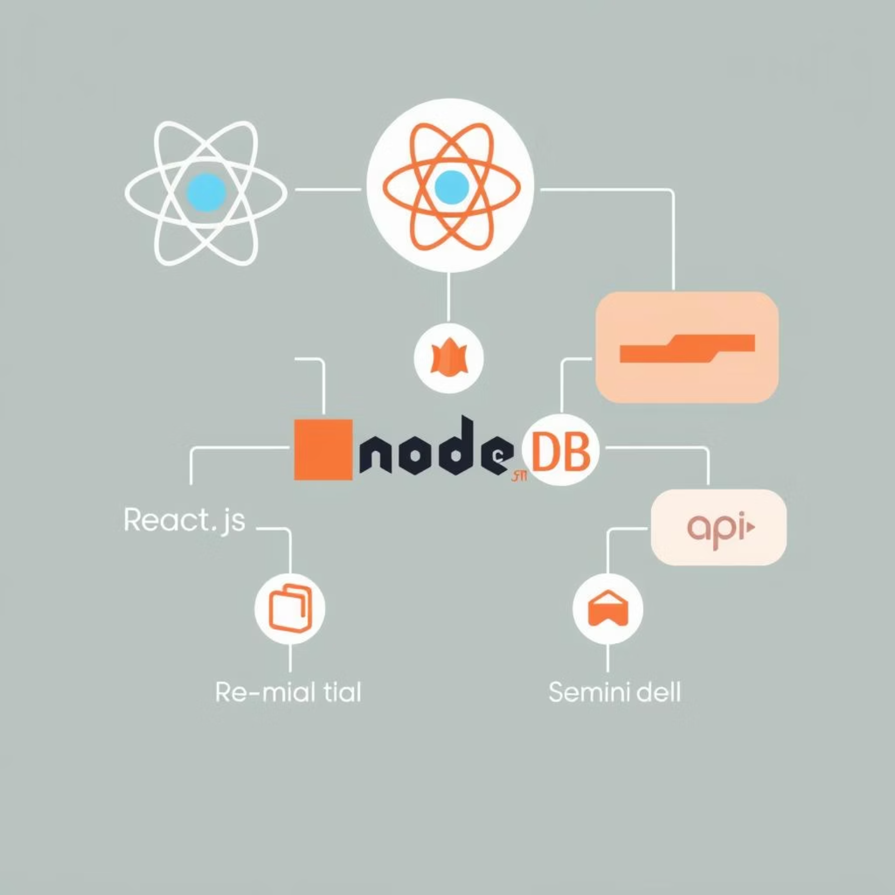
Architectural Foundation: The Tech Stack
The robust functionality of the AI Chatbot is built upon a modern and efficient tech stack, carefully selected to ensure scalability, performance, and maintainability. This foundation supports both the dynamic frontend and the powerful backend processing.
Frontend
AI & Document Processing
React: For building a dynamic and responsive user interface.
Gemini API: Integrates Google's advanced AI models for intelligent responses.
Tailwind CSS / Custom CSS: For modern, utility-first styling and flexible design.
PDF-parse, docx2txt, pptx: Libraries for extracting text content from various document formats.
Backend
Socket.io (if real-time messaging): Enables real-time, bidirectional communication for instant chat.
Axios: Promise-based HTTP client for making API requests.
Node.js: The JavaScript runtime for server-side logic.
Express: A fast, unopinionated, minimalist web framework for Node.js.
MongoDB (optional): NoSQL database for flexible session and chat history storage.

Slide 5
Project Structure: Organized for Clarity & Scalability
The project follows a well-defined directory structure, promoting clear separation of concerns, ease of development, and future scalability. This organization simplifies collaboration and streamlines maintenance for both frontend and backend components.
ai-chatbot/├── backend/│ ├── routes/ # API routes (auth, chat, file uploads)│ ├── controllers/ # Business logic for chat and file processing│ ├── models/ # MongoDB schemas (if session or user data)│ └── app.js # Express server└── frontend/ ├── src/ │ ├── components/ # Chat interface, message, file upload │ ├── pages/ # Home, Chat, About, Contact │ ├── services/ # API service calls │ └── App.js└── README.md
This modular approach ensures that developers can quickly locate and work on specific parts of the application, from API endpoints to UI components, without affecting the entire system.

Slide 6

Installation & Setup: Getting Started
Setting up the AI Chatbot project is straightforward, involving separate installations for the backend and frontend. Follow these steps to get the application up and running on your local machine.
Backend Setup
Frontend Setup
Clone the repository:git clone <repo-url>cd ai-chatbot/backend
Navigate to the frontend folder:cd ../frontend
Install dependencies:npm install
Install dependencies:npm install
Start the React app:npm run dev
Configure environment variables: Create a .env file with GEMINI_API_KEY, MONGO_URI, and JWT_SECRET.
Start the backend server:npm start

Slide 7
Usage Guide: Interacting with the Chatbot
Once installed, using the AI Chatbot is intuitive. The interface is designed for ease of use, allowing you to quickly engage with the AI, upload documents, and customize your experience.
01
02
Access the Application
Authentication (Optional)
Open the application in your preferred web browser to begin.
Sign up or log in if authentication features are implemented and required.
03
04
Start Chatting
Upload Documents
Engage directly with the AI in the main chat interface.
Use the upload feature to provide PDF, Word, or PPTX files for AI context.
05
06
View Responses & History
Customize Theme
Observe real-time AI responses and review your conversation history.
Toggle between dark and light modes for a personalized viewing experience.

Slide 8
API Endpoints: Backend Communication
The backend exposes a set of clear and concise API endpoints, facilitating seamless communication between the frontend and the server-side logic. These endpoints manage user authentication, chat interactions, and file uploads.
POST
/api/auth/login
Authenticates user login credentials.
POST
/api/auth/signup
Registers a new user account.
POST
/api/chat
Sends user messages to AI and retrieves AI responses.
POST
/api/upload
Handles the upload of PDF, Word, or PPTX files.
GET
/api/history
Fetches the user's chat history (if implemented).
These endpoints are designed for clear and efficient data exchange, forming the backbone of the chatbot's interactive capabilities.

Slide 9




Future Enhancements: Evolving the Chatbot Experience
The AI Chatbot with Gemini Integration is designed with extensibility in mind. Several exciting enhancements are planned to further expand its capabilities and improve the user experience, solidifying its position as a cutting-edge conversational AI platform.
Multi-Language Support
AI Document Summarization
Expanding the chatbot's reach by enabling conversations in multiple languages.
Implementing AI-powered summarization of uploaded documents for quick insights.
Voice Input/Output
Advanced Analytics
Integrating voice capabilities for a more natural and hands-free conversational experience.
Developing comprehensive analytics for chat patterns and user interactions to derive insights.
These future developments aim to make the chatbot even more versatile, accessible, and insightful for its users.

Slide 10
Conclusion: A New Era for AI Chatbots
The AI Chatbot with Gemini Integration represents a significant leap forward in conversational AI. By seamlessly blending real-time chat with the ability to contextualize information from uploaded documents, it offers an unparalleled level of intelligence and utility.
This project not only provides a powerful tool for intelligent assistance but also lays the groundwork for continuous innovation in human-AI interaction. We are confident that this application will empower users to achieve more by transforming how they access and utilize information.
For further inquiries or contributions, please contact:
Gopalajosyula Siva Satya Sai Bhagavan

